Slide 1

ONLINE SHOES WEBSITE
(StepUp Footwear)
Subject: 505 Advance Web Designing (AWD)
Submitted by:
Shubham Ashish Pancholi (3382)
Saumya Chaudhari (3235)
Vrushank Changawala (3234)
Group No.: 129
Project guided by:
Minal Desai
Assistant Professor

Slide 2
Content
Overview
Introduction
Scope & Objectives
Data Dictionary
ER Diagram
Data flow diagram
User Interface
Limitation & System Enhancements
Conclusion
References
Page 2
Sascma English Medium College BCA
Group No.: 129

Slide 3
Overview
Project Definition: A modern, full-stack footwear e-commerce Single Page Application (SPA) built using the MERN stack for BCA Semester 5.
Footwear Domain Focus: Dedicated online shoe store offering top athletic and casual footwear brands such as Nike, Adidas, Puma, Reebok, Skechers, and Converse.
Footwear Sizing Solution: Solves the primary footwear shopping challenge by providing explicit UK size selection (UK 6 to 11) with dynamic stock validation.
MERN Architecture: Combines React 18 & Vite frontend with Node.js/Express REST APIs and MongoDB document database.
Dual Operation Modules: Customer Storefront (catalog search, category filters, size selection, CartContext, Razorpay payment) and Admin Back-Office (product CRUD, orders status, reviews).
Page 3
Sascma English Medium College BCA
Group No.: 129

Slide 4
Introduction
Traditional Footwear Retail Issues: Shoppers travel to crowded physical shoe stores, spend hours searching racks, and often face disappointment when their specific shoe size is out of stock.
Manual Store Overhead: Physical footwear retailers struggle with paper stock registers, manual bill calculations, and delayed customer feedback handling.
Proposed MERN Solution: StepUp Footwear offers centralized real-time catalog visibility, instant shoe size availability, and automated subtotal/discount calculations.
Single Page Application (SPA): Built using React 18 and react-router-dom (v6), enabling instantaneous page transitions without full browser reloads.
Academic Relevance: Demonstrates mastery in Advance Web Designing (AWD) concepts: reusable React components, Context API state management, RESTful routing, and NoSQL modeling.
Page 4
Sascma English Medium College BCA
Group No.: 129

Slide 5
Scope & Objectives
PROJECT SCOPE
• Customer authentication with security CAPTCHA and JWT token storage.
• Footwear catalog with real-time brand filtering and category classification.
• Shoe details page featuring interactive UK size selection (Sizes 6 to 11).
• Global client state management using React Context (AuthContext & CartContext).
• Seamless order checkout with shipping address validation and Razorpay modal.
• Customer star ratings (1-5 stars), written reviews, and Contact Us messaging.
• Comprehensive Admin back-office for managing shoes, categories, brands, and orders.
PROJECT OBJECTIVES
• To build a responsive, high-performance footwear shopping SPA using React and Vite.
• To eliminate size-ordering confusion by requiring customers to choose UK shoe sizes.
• To implement secure RESTful APIs using Express.js, JWT tokens, and Bcrypt hashing.
• To model flexible, document-oriented footwear collections in MongoDB with Mongoose.
• To integrate Razorpay Standard Checkout in test mode for realistic payment simulation.
• To apply advanced modern web development practices taught in BCA Semester 5.
Page 5
Sascma English Medium College BCA
Group No.: 129

Slide 6
Environment & Technology Stack
HARDWARE & RUNTIME ENVIRONMENT
Development Machine
Intel Core i3 / AMD Ryzen 3 or higher, minimum 4 GB RAM (8 GB recommended for concurrent Node & Vite), 500 MB storage.
Operating System
Microsoft Windows 10 / Windows 11 (64-bit).
Server Runtime
Node.js (v18+) asynchronous event-driven JavaScript runtime environment.
Database Engine
MongoDB (awd_shoes_db) NoSQL document database with Mongoose ODM.
Development Tools
Visual Studio Code, MongoDB Compass, Postman REST API client.
SOFTWARE & WEB FRAMEWORKS (MERN)
Frontend Framework
React 18 with Vite build tool for ultra-fast Hot Module Replacement (HMR).
Client Routing & State
react-router-dom v6 for client routing; React Context API (AuthContext, CartContext).
Backend Framework
Express.js RESTful web framework with CORS, Multer, and JWT authentication.
Payment Gateway
Razorpay Standard Checkout Modal (Test Mode sandbox integration).
Page 6
Sascma English Medium College BCA
Group No.: 129

Slide 7
Data Dictionary (Part 1)
Database: awd_shoes_db — Collections: users, products, categories
Collection | Field Name | Data Type | Constraint | Description
users | _id | ObjectId | Primary Key | Unique MongoDB identifier for customer account
users | name | String | Required | Full name of customer
users | email | String | Required, Unique | Customer email address for login and notifications
users | password | String | Required | Bcrypt hashed password string
users | role | String | Dflt 'customer' | User role: 'customer' or 'admin'
users | address | String | Optional | Saved delivery street address
products | _id | ObjectId | Primary Key | Unique identifier for shoe model
products | name | String | Required | Footwear title (e.g. Air Zoom Pegasus, Ultraboost)
products | brand | String | Required | Brand manufacturer (Nike, Adidas, Puma, etc.)
products | category | ObjectId | FK (categories) | Reference to footwear category
products | price | Number | Required | Shoe price in Indian Rupees (INR)
products | stock | Number | Required | Available stock quantity in inventory
products | sizes | Array of Num | Required | Supported UK sizes array: [6, 7, 8, 9, 10, 11]
categories | _id | ObjectId | Primary Key | Unique category identifier
categories | name | String | Required, Unique | Category name: Running, Casual, Formal, Boots
Page 7
Sascma English Medium College BCA
Group No.: 129

Slide 8
Data Dictionary (Part 2)
Database: awd_shoes_db — Collections: orders, reviews, brands, contactmessages
Collection | Field Name | Data Type | Constraint | Description
orders | _id | ObjectId | Primary Key | Unique MongoDB order identifier
orders | user | ObjectId | FK (users) | Customer account placing order
orders | items | Array of Docs | Required | Subdocuments containing product ID, UK size, quantity
orders | totalAmount | Number | Required | Final calculated invoice total in INR
orders | shippingAddress | String | Required | Customer delivery street and city address
orders | paymentStatus | String | Dflt 'Pending' | Payment status: Pending / Paid
orders | orderStatus | String | Dflt 'Pending' | Status: Pending, Processing, Shipped, Delivered
reviews | _id | ObjectId | Primary Key | Unique review identifier
reviews | product | ObjectId | FK (products) | Reference to reviewed footwear product
reviews | user | ObjectId | FK (users) | Reference to reviewing customer
reviews | rating | Number | Required (1 to 5) | Customer star rating for comfort and quality
brands | _id | ObjectId | Primary Key | Unique brand partner record
brands | name | String | Required, Unique | Footwear brand name (Nike, Adidas, Puma, etc.)
contactmessages | _id | ObjectId | Primary Key | Customer inquiry message identifier
Page 8
Sascma English Medium College BCA
Group No.: 129

Slide 9
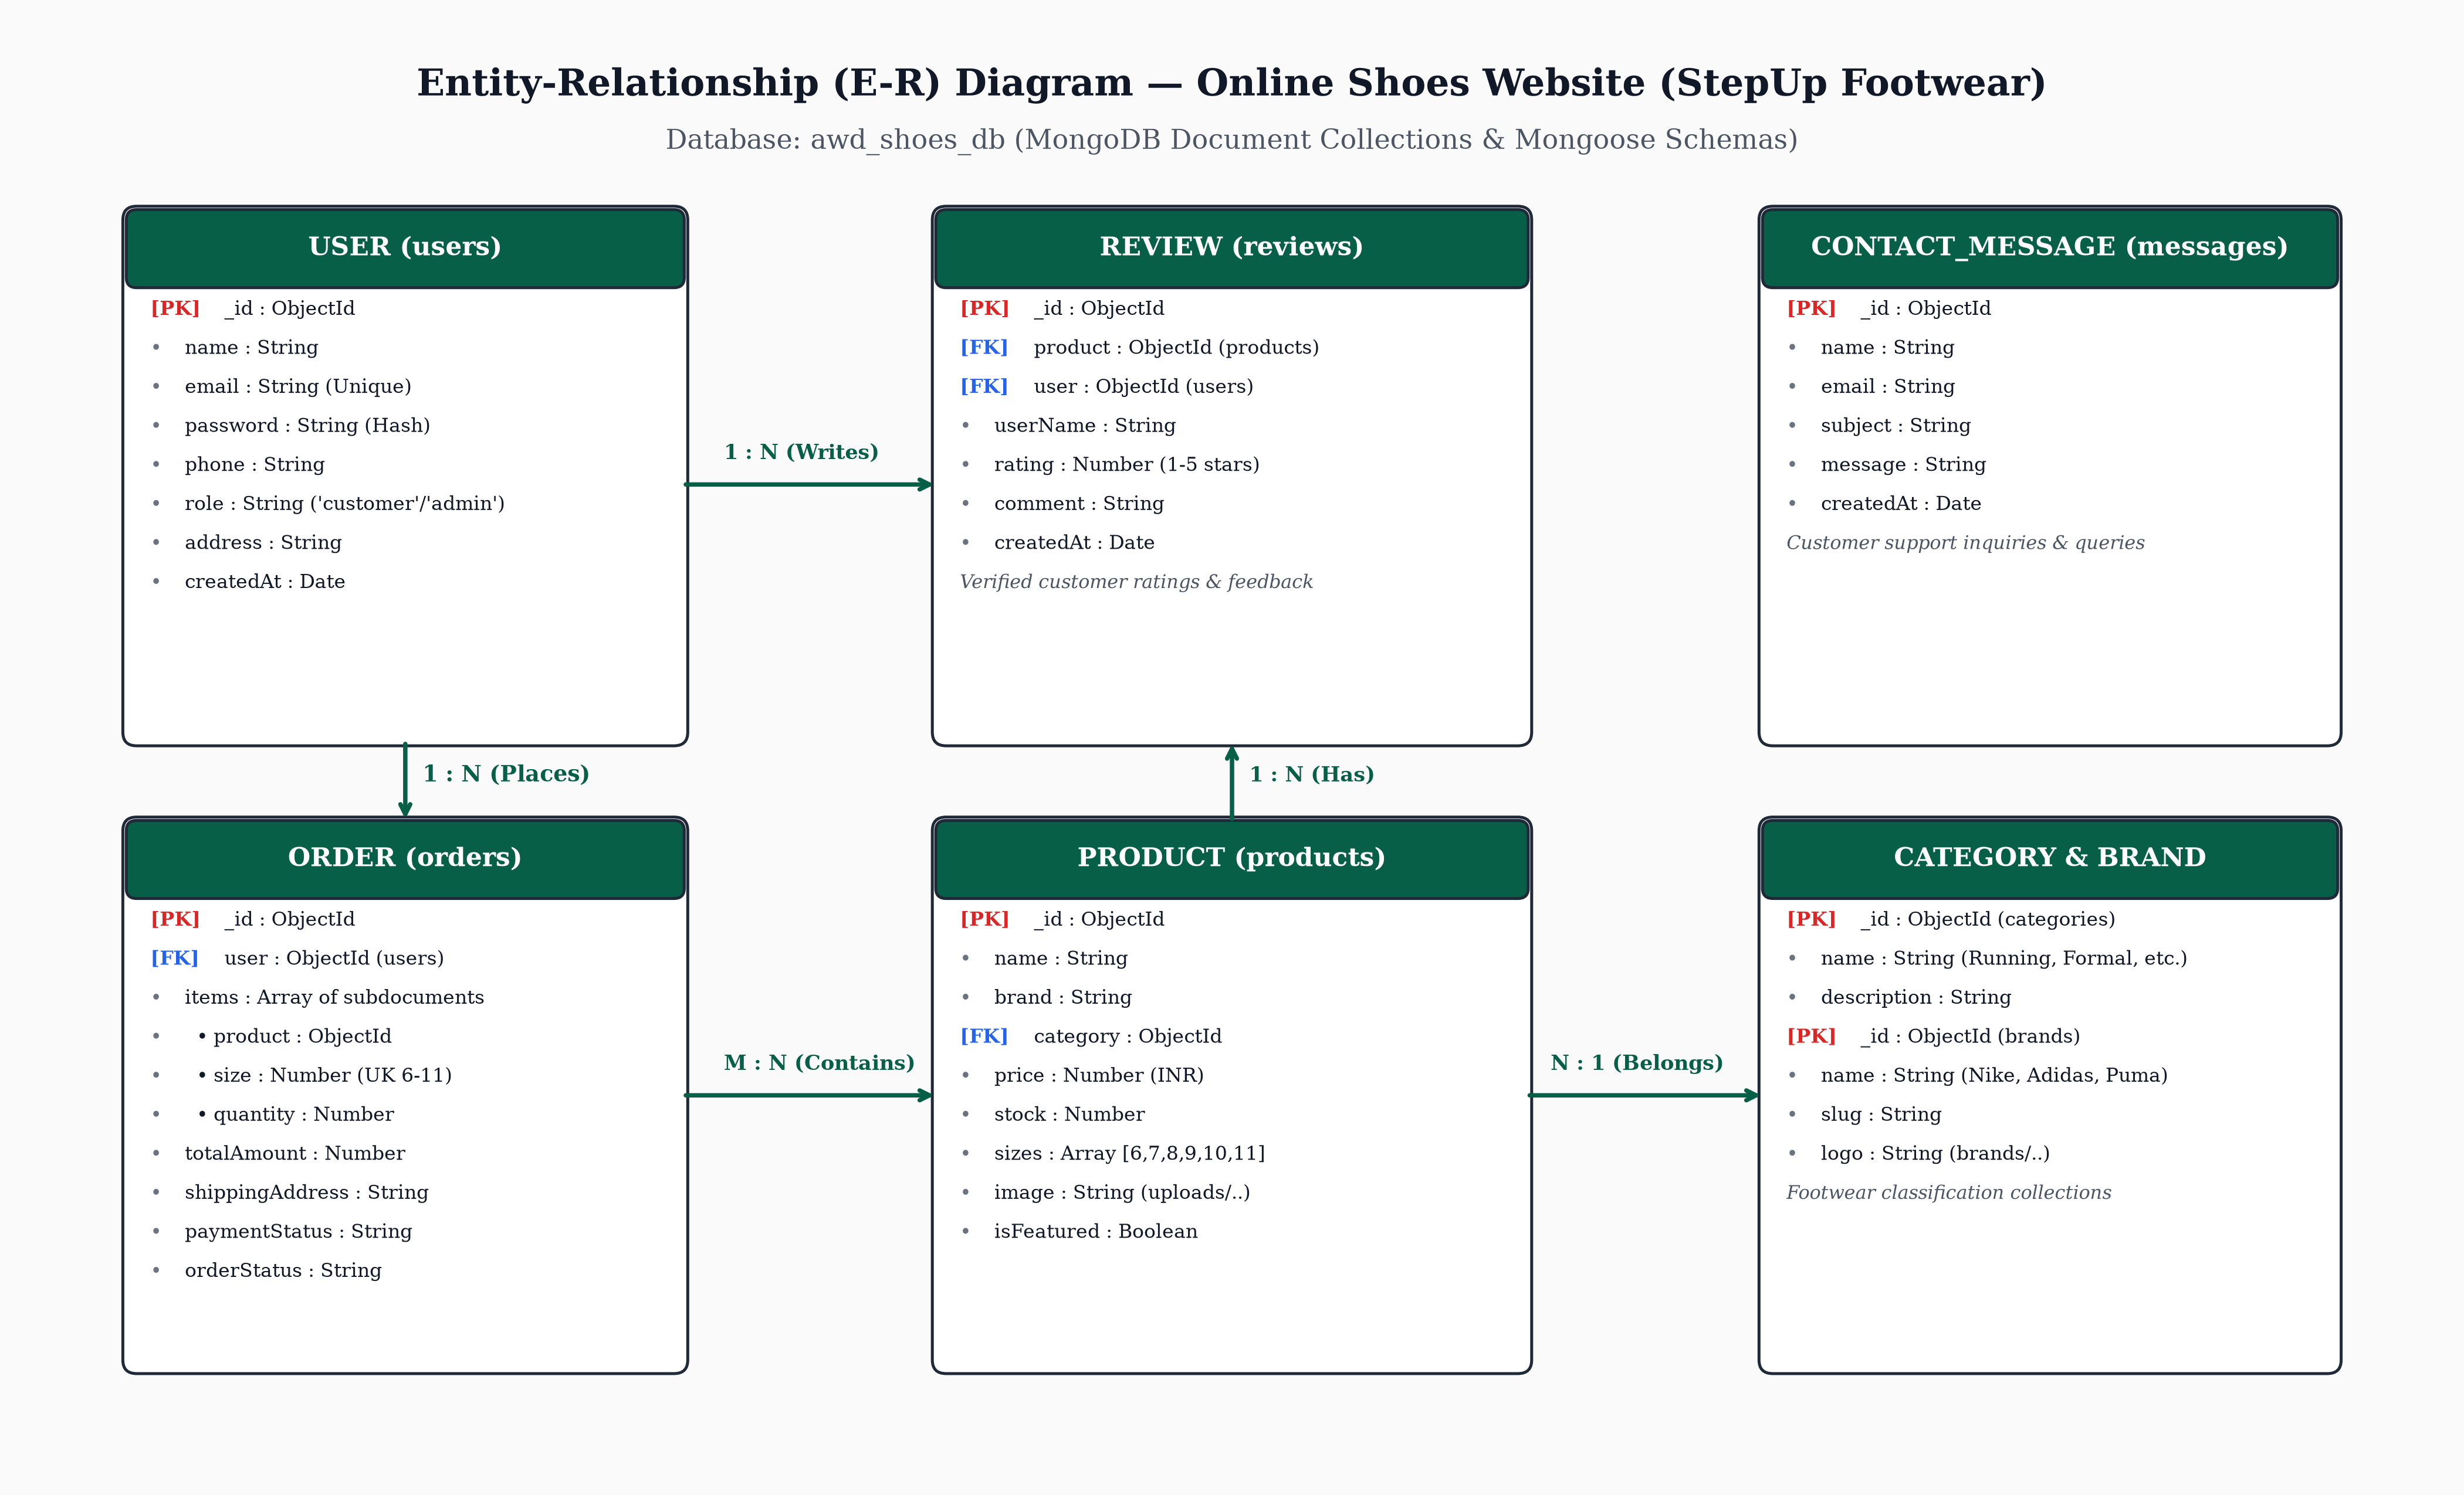
ER Diagram
Figure: Entity-Relationship Diagram for Online Shoes Website (awd_shoes_db Collections)
Page 9
Sascma English Medium College BCA
Group No.: 129

Slide 10
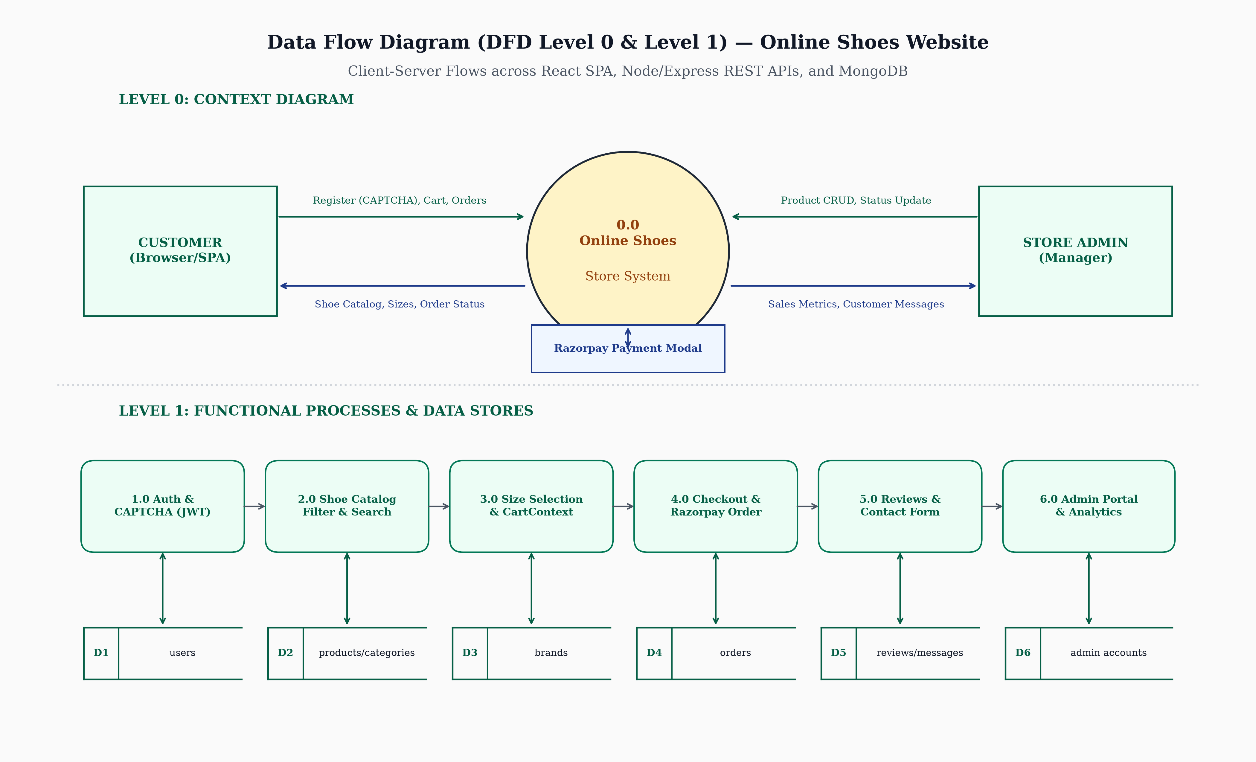
Data Flow Diagram
Figure: DFD Level 0 (Context Diagram) and Level 1 Functional Data Flows across React SPA, Node REST APIs, and MongoDB
Page 10
Sascma English Medium College BCA
Group No.: 129

Slide 11
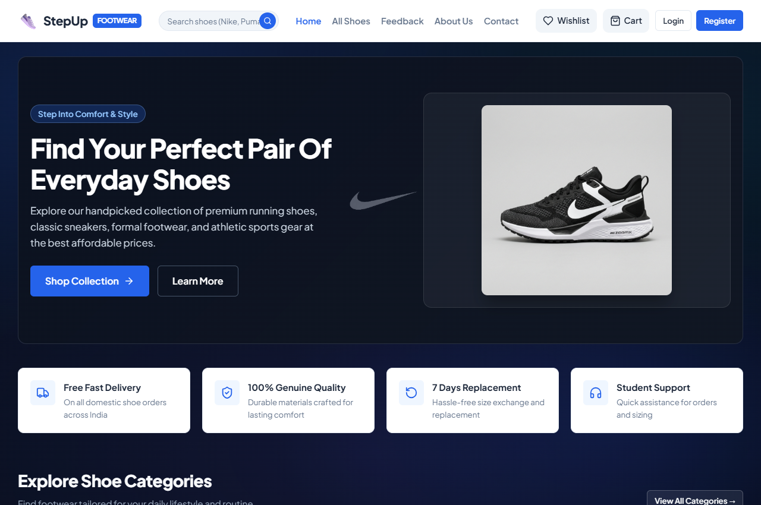
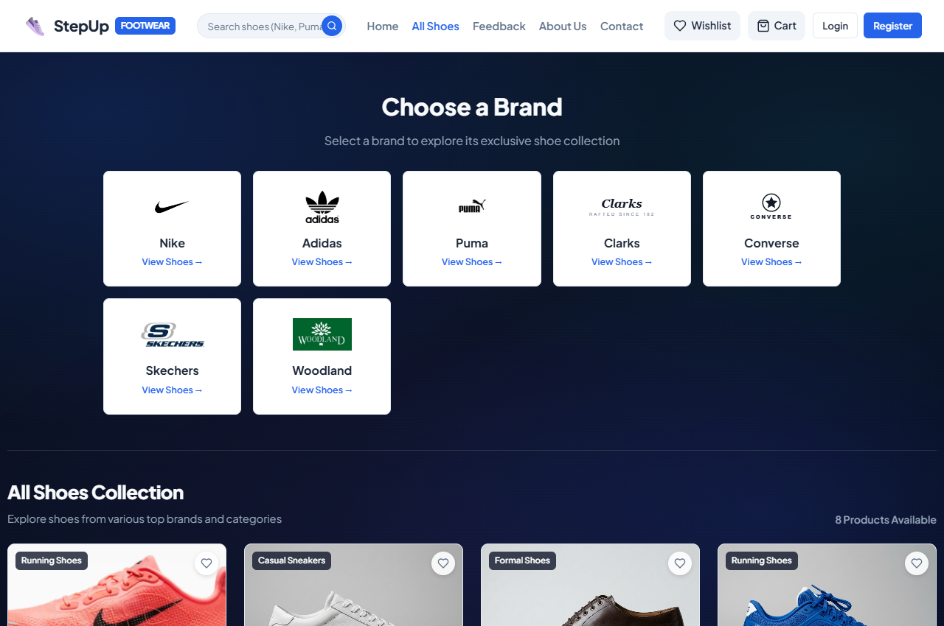
User Interface: Home Page & Footwear Catalog
Figure 1: Home Page
Displays modern hero banner, popular brand logos carousel, featured shoes grid, and value highlights.
Figure 2: All Shoes Catalog Page
Displays entire footwear collection with brand filters (Nike, Adidas), category badges, and price sorting.
Page 11
Sascma English Medium College BCA
Group No.: 129

Slide 12
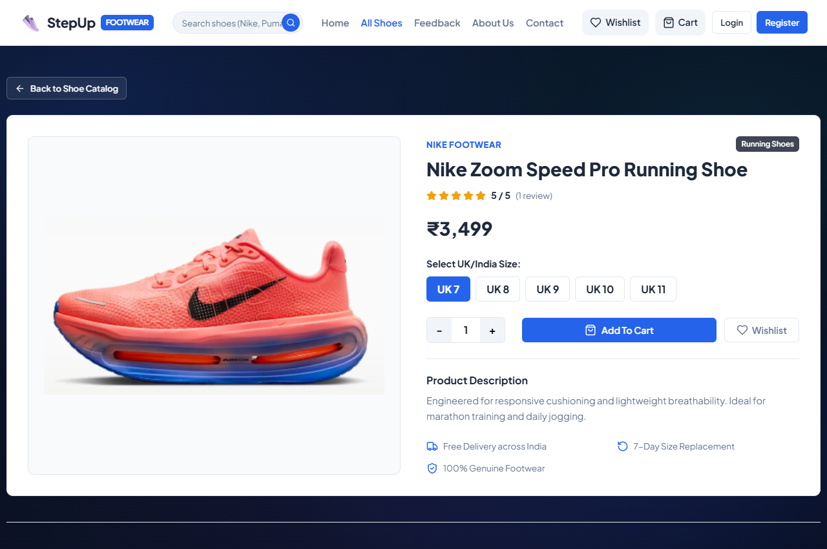
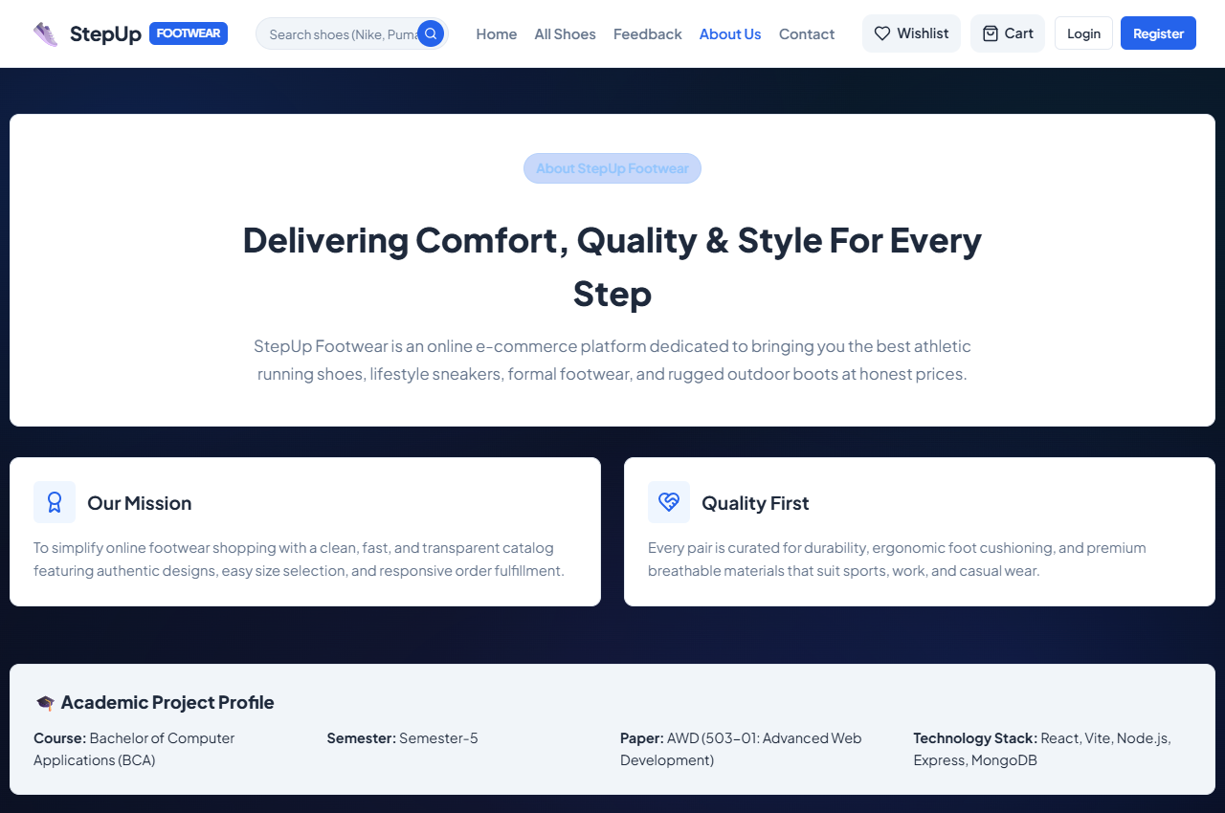
User Interface: Shoe Details & Size Selection
Figure 3: Product Details & UK Sizing
Shows high-resolution shoe imagery, detailed descriptions, and interactive UK size buttons (6 to 11).
Figure 4: About Us Store Page
Presents store heritage, quality footwear assurance, brand partnerships, and customer support standards.
Page 12
Sascma English Medium College BCA
Group No.: 129

Slide 13
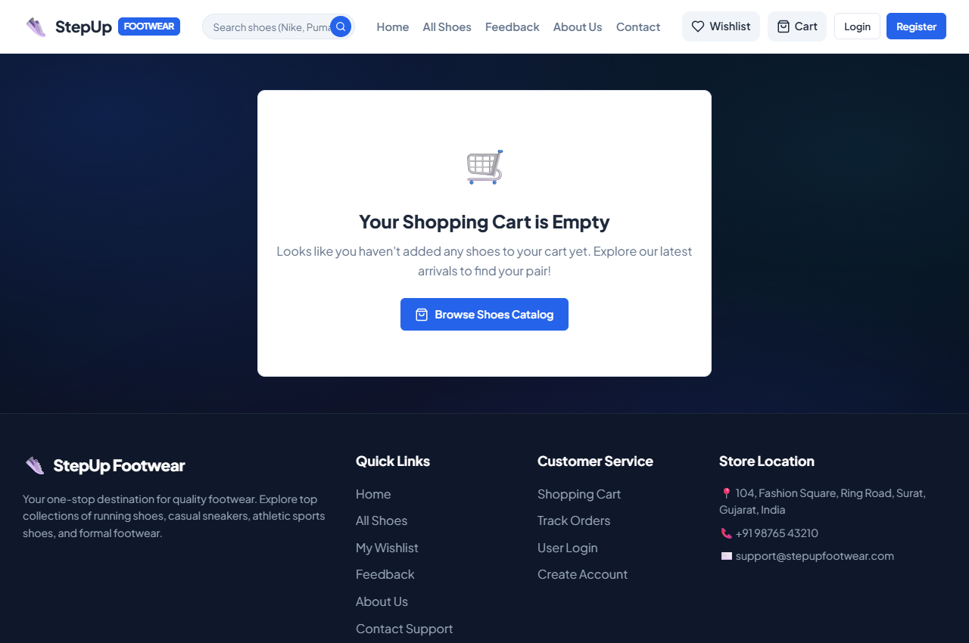
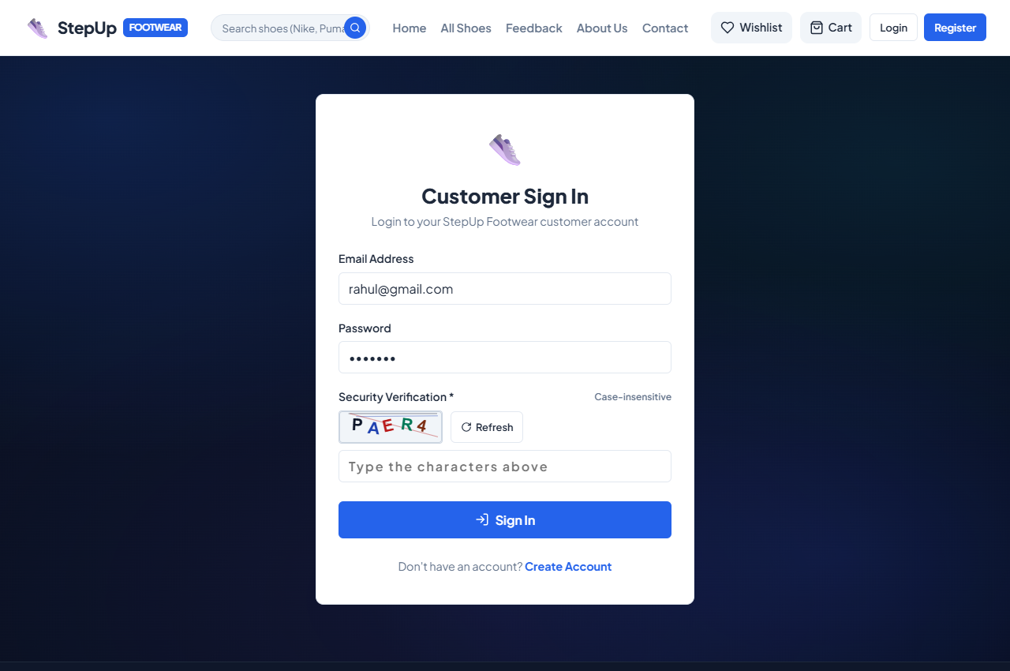
User Interface: Shopping Cart & Checkout Form
Figure 5: Responsive Shopping Cart
Displays chosen shoes with selected UK size badge, quantity controls, price subtotal, and tax summary.
Figure 6: Delivery Checkout & Payment
Collects customer shipping address and triggers the official Razorpay test checkout modal.
Page 13
Sascma English Medium College BCA
Group No.: 129

Slide 14

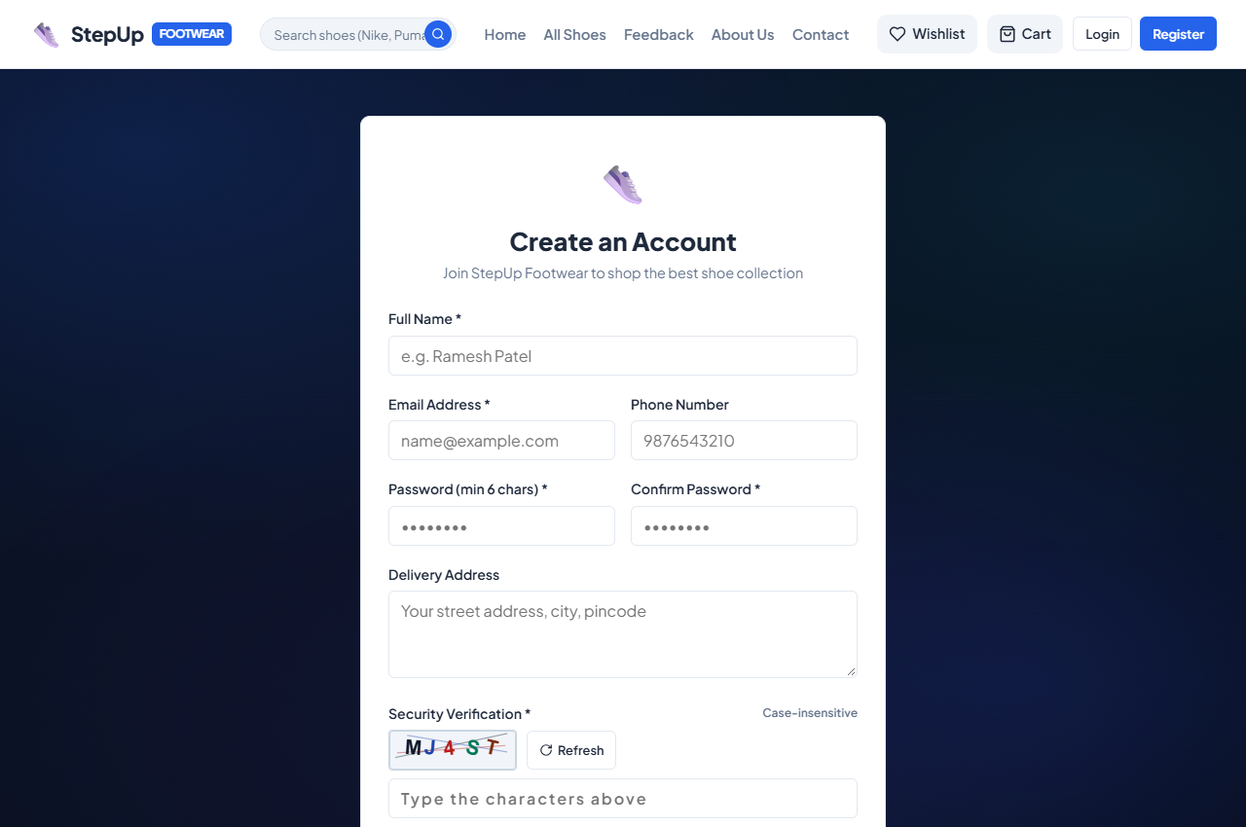
User Interface: Customer Login & Registration
Figure 7: Customer Login with CAPTCHA
Secure login form featuring mathematical security CAPTCHA to prevent automated bot login attempts.
Figure 8: Customer Registration Form
Customer sign-up interface collecting name, email, phone, password, and CAPTCHA validation.
Page 14
Sascma English Medium College BCA
Group No.: 129

Slide 15
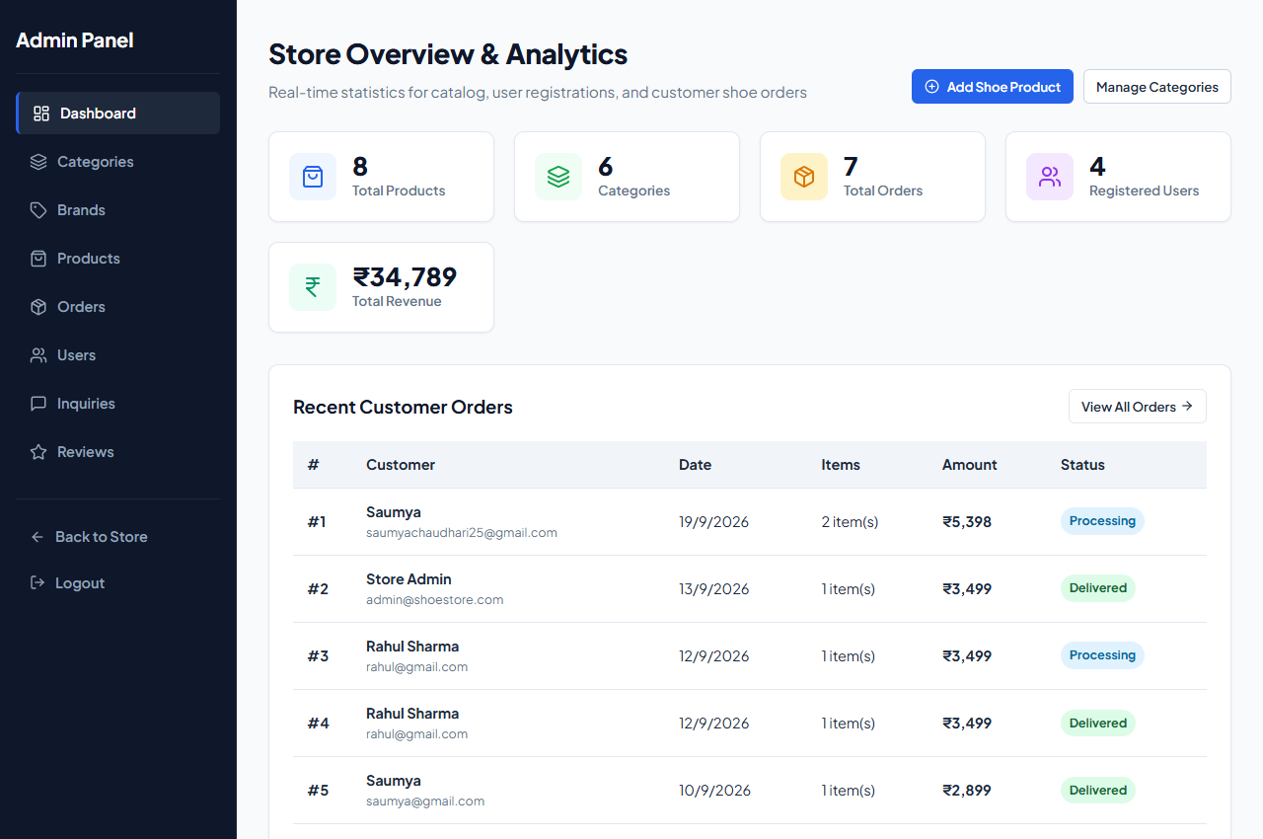
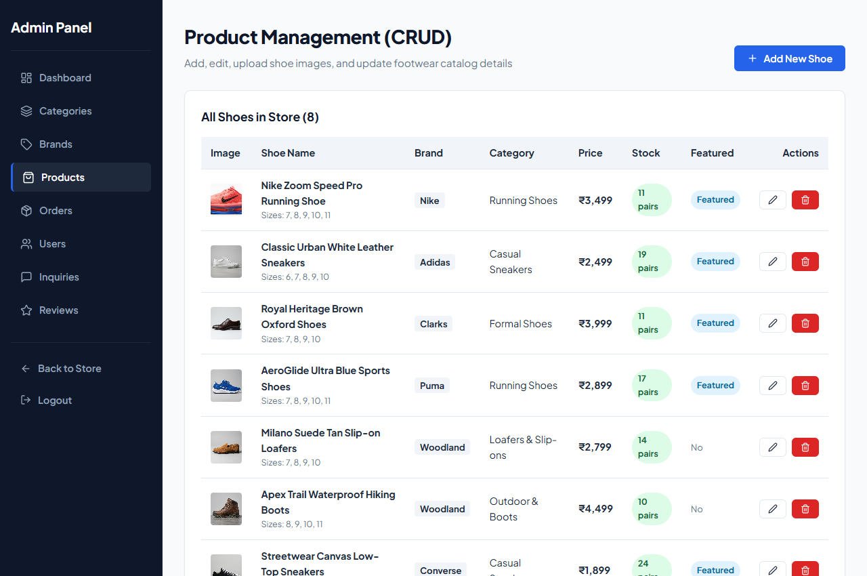
User Interface: Admin Dashboard & Product Controls
Figure 9: Administrative Dashboard
Overview screen presenting total sales metrics, order counts, product inventory summary, and quick links.
Figure 10: Shoe Products Inventory Table
Allows store managers to add new footwear models, adjust pricing, upload images, and control stock availability.
Page 15
Sascma English Medium College BCA
Group No.: 129

Slide 16
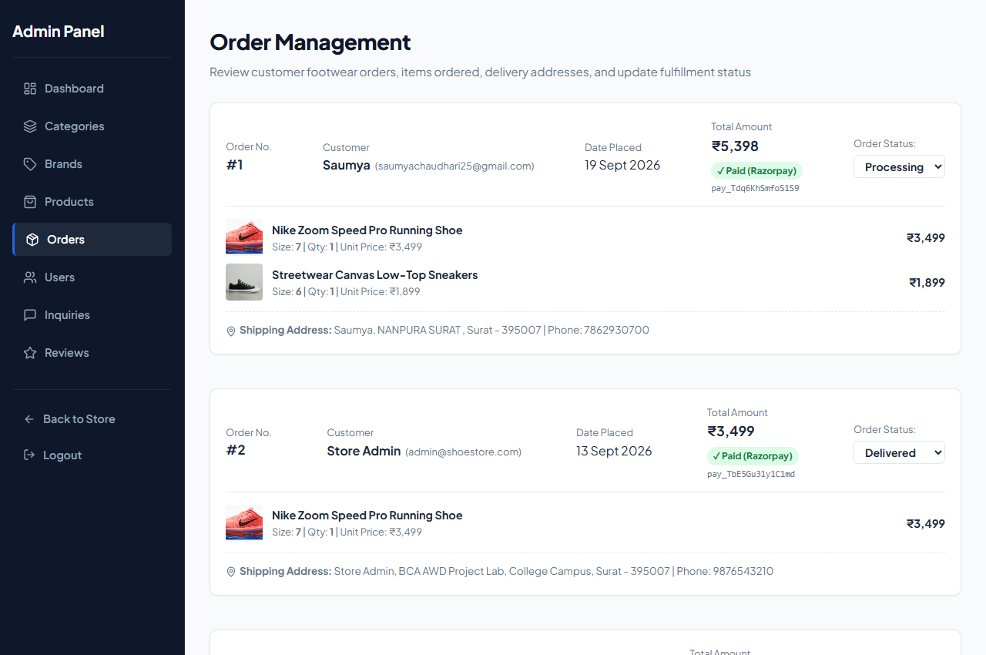
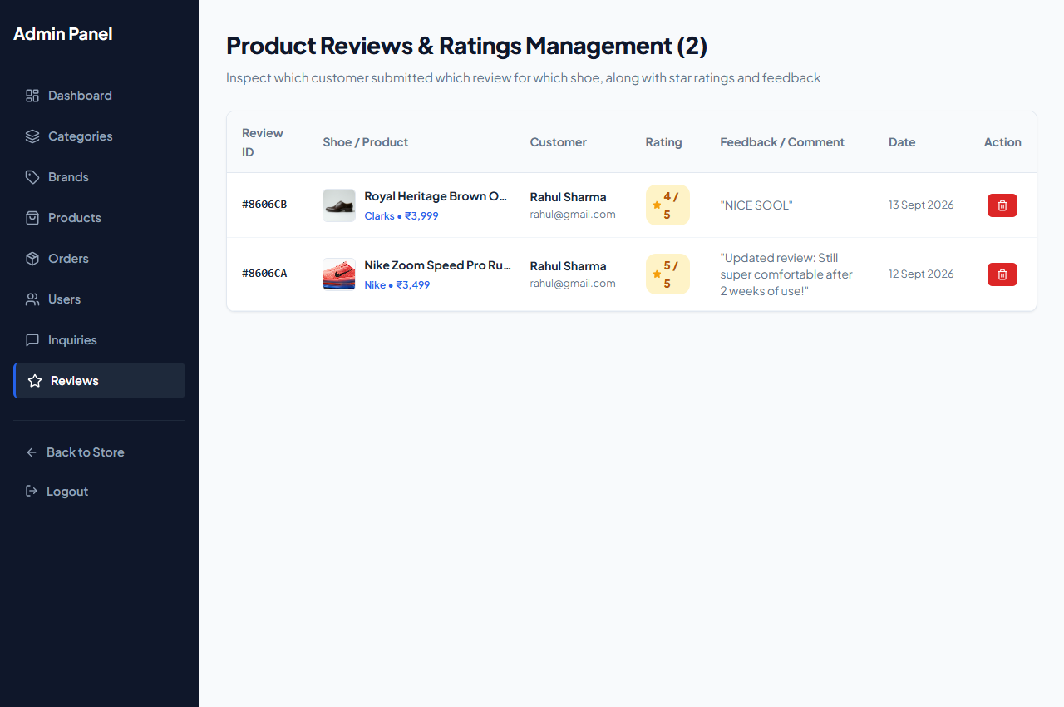
User Interface: Order Management & Review Moderation
Figure 11: Admin Orders Management
Displays all customer orders, delivery addresses, payment status, and order status update dropdowns.
Figure 12: Customer Review Moderation
Enables administrators to view star ratings, monitor customer feedback, and moderate published shoe reviews.
Page 16
Sascma English Medium College BCA
Group No.: 129

Slide 17
Limitation & System Enhancements
SYSTEM LIMITATIONS
Single Currency Operations
Transactions and pricing are strictly denominated in Indian Rupees (INR — ₹); international currency conversion is not supported.
Single Vendor Architecture
Designed for a single shoe store business; multi-vendor merchant onboarding is not currently supported.
Email Notification Scope
Order receipts are displayed in the app and stored in MongoDB; automated SMTP / Nodemailer email alerts are pending.
Standard Sizing Scope
Offers standard UK shoe sizes (6 to 11) without interactive camera-based foot 3D scanning tools.
FUTURE SYSTEM ENHANCEMENTS
Automated Email & SMS Dispatch
Integrating Nodemailer and SMS APIs (such as Twilio) to send automatic dispatch tracking numbers and delivery alerts.
Interactive Foot Size Advisor
Introducing a foot length measurement calculator to guide customers to their ideal size and reduce return rates.
Customer Return & Refund Portal
Adding a dedicated customer portal for return requests with administrator approval workflows.
Promotional Coupon Code Engine
Enabling administrators to create seasonal discount coupon promo codes with expiry dates.
Progressive Web App (PWA)
Configuring service workers for offline catalog caching and installable mobile app experience on smartphones.
Page 17
Sascma English Medium College BCA
Group No.: 129

Slide 18
Conclusion
Successful MERN Stack Deployment: The Online Shoes Website (StepUp Footwear) successfully demonstrates a modern, scalable full-stack e-commerce Single Page Application.
Effective Sizing Problem Solution: Effectively addressed the primary problem in online footwear retail through explicit UK size selection integrated into the CartContext.
Robust Backend Architecture: Demonstrated RESTful API design with Express.js, JWT authentication, Bcrypt security, and NoSQL document modeling in MongoDB.
Intuitive User Experience: Achieved instantaneous client-side navigation, interactive filters, CAPTCHA security, and simulated Razorpay payment.
Academic Competency: Provided hands-on mastery of modern web architecture and Advance Web Designing (AWD) principles taught in BCA Semester 5.
Page 18
Sascma English Medium College BCA
Group No.: 129

Slide 19
References
Textbooks & Academic References:
• Alex Banks and Eve Porcello, 'Learning React: Modern Patterns for Developing React Apps', 2nd Edition, O'Reilly Media, 2020.
• Greg Lim, 'Beginning Node.js, Express & MongoDB Development', Independently Published, 2021.
• Robin Nixon, 'Learning PHP, MySQL & JavaScript: With jQuery, CSS & HTML5', 6th Edition, O'Reilly Media, 2021.
• Roger S. Pressman, 'Software Engineering: A Practitioner's Approach', 8th Edition, McGraw-Hill Education, 2014.
Official Documentation & Online Resources:
• React.js Official Documentation: https://react.dev/ — Components, hooks (useState, useEffect, useContext), and JSX syntax.
• Node.js & Express.js Documentation: https://nodejs.org/ and https://expressjs.com/ — Server runtime and REST APIs.
• MongoDB & Mongoose Documentation: https://www.mongodb.com/docs/ and https://mongoosejs.com/docs/ — NoSQL schemas.
• Razorpay Payments Documentation: https://razorpay.com/docs/ — Standard checkout modal integration.
• MDN Web Docs (Mozilla Developer Network): https://developer.mozilla.org/ — Modern HTML5, CSS3, and JavaScript standards.
Page 19
Sascma English Medium College BCA
Group No.: 129

Slide 20
THANK YOU

